Slide 1
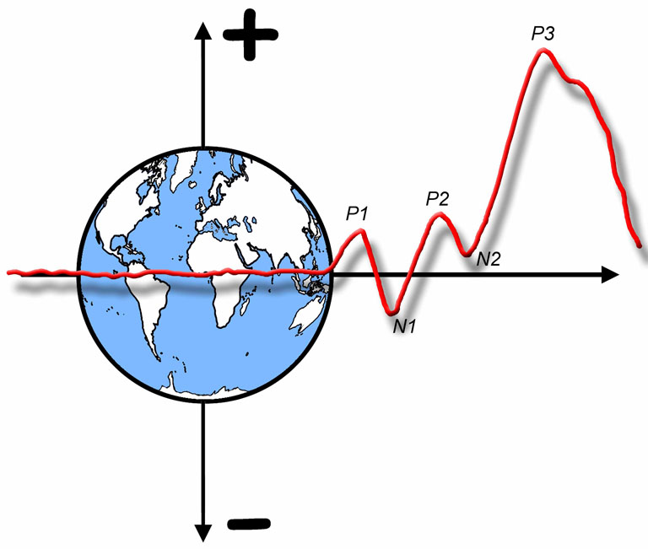

The ERP Boot Camp
Recording the EEG

Slide 2
Importance of Clean Data
ERPs are tiny
Many experimental effects are less than a millionth of a volt
ERPs are embedded in noise that is 20-100 µV
Averaging is a key method to reduce noise
S/N ratio is a function of sqrt(# of trials)
Doubling # of trials increases S/N ratio by 41% [sqrt(2)=1.41]
Quadrupling # of trials doubles S/N ratio [sqrt(4)=2]
Notes:
© S. J. Luck. All Rights Reserved. May be used for nonprofit educational purposes if this copyright notice is included. Permission must be obtained from the copyright holder(s) for any other use.

Slide 3
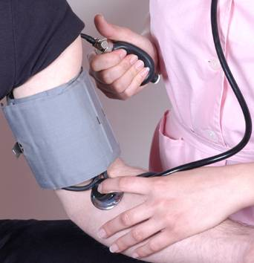
Individual Trials
Averaged Data
Look at prestimulus baseline to see noise level
Notes:
Figure 4.1 from Luck, S. J., An Introduction to the Event-Related Potential Technique. Cambridge, MA: MIT Press. © MIT Press. This material may be used for nonprofit research and education purposes only, and it may not be reprinted or distributed in any form including print and electronic forms.
Other content: © S. J. Luck. All Rights Reserved. May be used for nonprofit educational purposes if this copyright notice is included. Permission must be obtained from the copyright holder(s) for any other use.

Slide 4
Importance of Clean Data
Just having a lot of trials is often not enough to get clean data
It pays to reduce sources of noise before the noise is recorded
Hansen’s Axiom: There is no substitute for clean data
Cleaning up noise after recording has a cost
Averaging requires lots of trials (lots of time)
Filters distort the time course of the ERPs
By reducing sources of noise before they are recorded, you could cut an hour off every recording session or cut the number of subjects in each experiment by 25% (or even more)
Notes:
© S. J. Luck. All Rights Reserved. May be used for nonprofit educational purposes if this copyright notice is included. Permission must be obtained from the copyright holder(s) for any other use.

Slide 5

My View of Signal Processing
Treatments always have side effects
According to Wikipedia:
Common adverse effects include: nausea, dyspepsia, gastrointestinal bleeding, raised liver enzymes, diarrhea, epistaxis, headache, dizziness, unexplained rash, salt and fluid retention, and hypertension
Infrequent adverse effects include: oesophageal ulceration, hyperkalaemia, renal impairment, confusion, bronchospasm, and heart failure
Notes:
© S. J. Luck. All Rights Reserved. May be used for nonprofit educational purposes if this copyright notice is included. Permission must be obtained from the copyright holder(s) for any other use.

Slide 6
My View of Signal Processing
Treatments always have side effects
NOISE
Filter
According to Luckipedia:
Common adverse effects include: distortion of onset times, distortion of offset times, unexplained peaks, slight dumbness of conclusions
Infrequent adverse effects include: artificial oscillations, wildly incorrect conclusions, public humiliation by reviewers, grant failure
Notes:
© S. J. Luck. All Rights Reserved. May be used for nonprofit educational purposes if this copyright notice is included. Permission must be obtained from the copyright holder(s) for any other use.

Slide 7

Absolute Voltage
Voltage is potential for charges to move from one place to another
No such thing as voltage at one electrode
Potential for liquid to flow depends on source and destination
Voltage is measured between two electrodes
However, we can think of absolute voltage as the potential for charges to move from one site to the average of the surface of the head
This is never truly achieved
It is rarely approximated very well
Notes:
© S. J. Luck. All Rights Reserved. May be used for nonprofit educational purposes if this copyright notice is included. Permission must be obtained from the copyright holder(s) for any other use.

Slide 8
Active, Reference, & Ground
For each channel, you need active, reference, and ground electrodes (in a typical system)
Voltage is measured between ACTIVE and GROUND (A - G)
Voltage is measured between REFERENCE and GROUND (R - G)
Output is difference between these voltages
(A - G) - (R - G) = A - R
It’s as if the ground does not exist
Any noise in common to A and R will be eliminated
Notes:
Figure 3.1 from Luck, Steven J. (2005). An introduction to the Event-Related Potential Technique. Cambridge, MA: MIT Press.© MIT Press. This material may be used for nonprofit research and education purposes only, and it may not be reprinted or distributed in any form including print and electronic forms.
Other content: © S. J. Luck. All Rights Reserved. May be used for nonprofit educational purposes if this copyright notice is included. Permission must be obtained from the copyright holder(s) for any other use.

Slide 9
Common Mode Rejection
The ground signal is completely subtracted away (in theory)
This is good, because the amplifier’s ground circuit can pick up all kinds of crud
You can put the ground electrode anywhere on the head
The noise won’t be subtracted away perfectly if the (A - G) and (R - G) signals aren’t treated equivalently
(A-G) - .9(R-G) = A - .9R - .1G
An amplifier’s “common mode rejection” is it’s ability to treat these signals equivalently and reject noise that is common to them
Common mode rejection declines when impedance goes up, especially if the impedances differ from each other
This is one reason to keep electrode impedances low
Notes:
© S. J. Luck. All Rights Reserved. May be used for nonprofit educational purposes if this copyright notice is included. Permission must be obtained from the copyright holder(s) for any other use.

Slide 10
BioSemi: CMS and DRL
BioSemi records the “single-ended” signal instead of a “differential” signal
Voltage measured between each site and CMS
Common Mode Sense (equivalent to ground)
Referencing is done offline
Simply subtract a reference channel from every other channel
Also: Driven Right Leg (DRL)
Injects a tiny voltage into the scalp to bring the average scalp potential near the amplifier’s ground potential
If the potential between a given electrode and ground is low, you will pick up less noise
Biosemi does not save filtered and referenced data!!!
Notes:
© S. J. Luck. All Rights Reserved. May be used for nonprofit educational purposes if this copyright notice is included. Permission must be obtained from the copyright holder(s) for any other use.

Slide 11
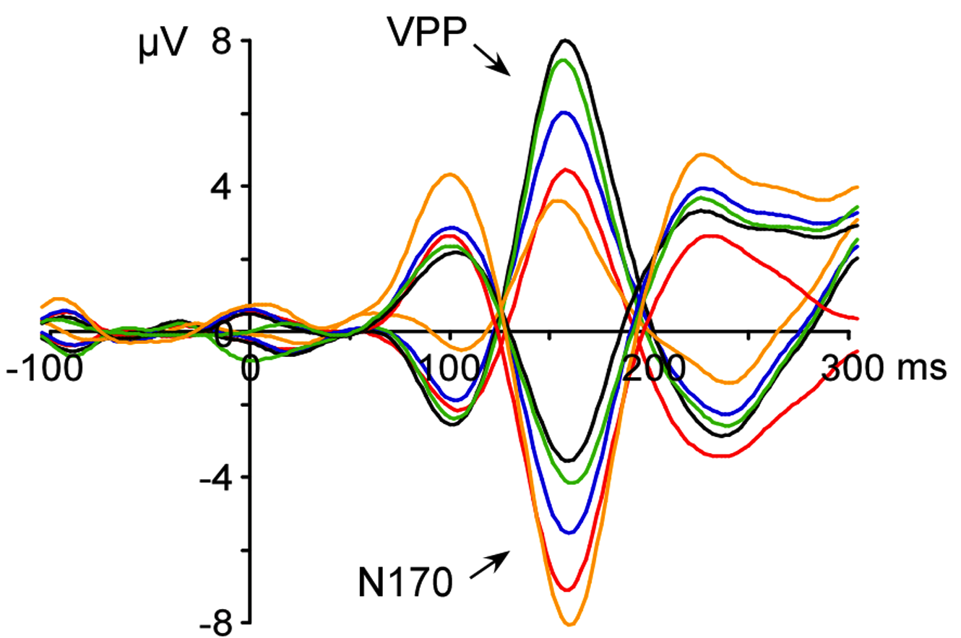
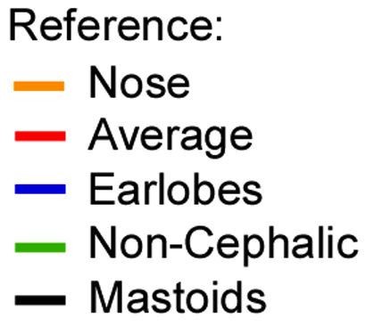
The Reference Electrode
Ideal: Active electrode placed at site where voltage is changing; reference electrode placed at neutral site
Reality: There is no neutral site
For any given dipole, there will be a line of zero voltage, but this line varies depending on the position and orientation of the dipole
All recordings are actually “bipolar”
ERPs can look very different with different references
Notes:
From Rossion, B., & Jacques, C. (i2012). The N170: Understanding the time course of face perception in the human brain. In S. J. Luck & E. S. Kappenman (Eds.), Oxford Handbook of Event-Related Potential Components. New York: Oxford University Press. © Oxford University Press.
Other content: © S. J. Luck. All Rights Reserved. May be used for nonprofit educational purposes if this copyright notice is included. Permission must be obtained from the copyright holder(s) for any other use.

Slide 12
The Reference Electrode
Fundamental principle: Always think of ERPs as a difference between the active and reference sites
Corollary: Put the reference electrode in a convenient location
Not biased toward one hemisphere or the other
Easy to attach with low impedance
Not distracting
Frequently used by other investigators so that waveforms can easily be compared
Best compromise in most cases: Average of mastoids (or earlobes, which are electrically equivalent)
Notes:
© S. J. Luck. All Rights Reserved. May be used for nonprofit educational purposes if this copyright notice is included. Permission must be obtained from the copyright holder(s) for any other use.

Slide 13
Average Mastoids Reference
How to re-reference with active electrode sites at A and Rm, both recorded with Lm as the reference:
a = A - Lm Recorded value at A
r = Rm - Lm Recorded value at Rm
a' = A - (Lm+Rm)÷2 This is what we want
a' = A - Lm÷2 - Rm÷2 Same as above, rearranged
a' = A - (Lm-(Lm÷2)) - (Rm÷2) Because Lm÷2 = Lm – (Lm÷2)
a' = (A - Lm) - ((Rm-Lm)÷2) Same as above , rearranged
a' = a - (r÷2) Substitute a for (A - Lm) and r for (Rm-Lm)
In words: To re-reference to the average of the mastoids, simply subtract half of the signal recorded between the two mastoids from each channel
Biosemi: a' = a – ((Lm+Rm)÷2) Subtract average of mastoids
Notes:
© S. J. Luck. All Rights Reserved. May be used for nonprofit educational purposes if this copyright notice is included. Permission must be obtained from the copyright holder(s) for any other use.

Slide 14
Average Reference
Alternative: re-reference to the average of all sites
This is an approximation of the absolute voltage
It may reduce noise (because the signal being subtracted from all sites is an average)
But it can be a bad and misleading approximation
The waveforms will look quite different depending on what set of electrodes you’ve used
Every time point, component, and experimental effect will show a polarity inversion somewhere
Recommendation: Look at your data referenced in several different ways
Notes:
© S. J. Luck. All Rights Reserved. May be used for nonprofit educational purposes if this copyright notice is included. Permission must be obtained from the copyright holder(s) for any other use.

Slide 15
Notes:
Figure 5.2 from Luck, S.J. (2014). An Introduction to the Event-Related Potential Technique, Second Edition. Cambridge, MA: MIT Press. © MIT Press.
This material may be used for nonprofit research and education purposes only, and it may not be reprinted or distributed in any form including print and electronic forms.

Slide 16
Reference =
Average of Fz, Cz, Pz,
O1/O2, and T5/T6
Reference =
Left Mastoid
Reference=
Average of Fz, Cz, Pz
Notes:
Figure 3.2 from from Luck, Steven J. (2005). An introduction to the Event-Related Potential Technique. Cambridge, MA: MIT Press. © MIT Press. This material may be used for nonprofit research and education purposes only, and it may not be reprinted or distributed in any form including print and electronic forms.
Other content: © S. J. Luck. All Rights Reserved. May be used for nonprofit educational purposes if this copyright notice is included. Permission must be obtained from the copyright holder(s) for any other use.

Slide 17
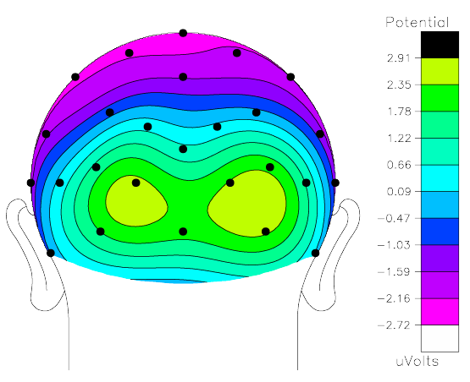
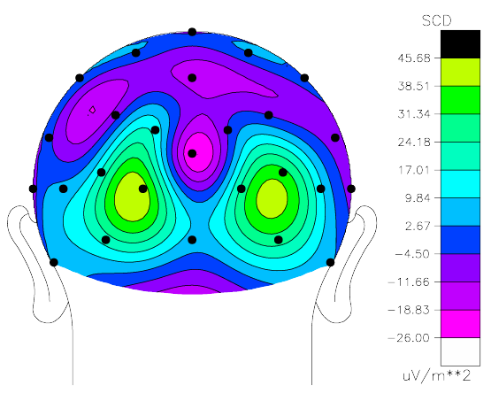
Current Density
Another option is to convert the data into current density, which is reference-free
This reflects the current flowing outward at each point of the scalp
Calculated as the 2nd derivative over space (Laplacian)
Emphasizes superficial sources; deep sources are attenuated
Estimates are poor at edges of electrode array
Voltage
Current Density
Notes:
© S. J. Luck. All Rights Reserved. May be used for nonprofit educational purposes if this copyright notice is included. Permission must be obtained from the copyright holder(s) for any other use.

Slide 18
When to Re-Reference?
The order of operations does not matter for “linear operations”
Averaging and re-referencing are both linear operations
Re-referencing before or after averaging yields exactly the same result
Artifact rejection is nonlinear
Re-reference before rejection if it helps rejection
Same principles apply to linear filters
y = c + bx Simple line
y = c + b₁x₁ + b₂x₂ + b₃x₃ … Multiple regression
y = ⅓x₁ + ⅓x₂ + ⅓x₃ Averaging
y = ch1+ (-.5)ch14 Re-referencing
Notes:
© S. J. Luck. All Rights Reserved. May be used for nonprofit educational purposes if this copyright notice is included. Permission must be obtained from the copyright holder(s) for any other use.

Slide 19
Environmental Noise
An oscillating voltage in a conductor will induce an oscillating voltage in a nearby conductor
Example: AC lights induce voltage in electrode wires
This is potentiated for coils of wire
A major source of noise is line-frequency AC oscillations (60 Hz in N. America; 50 Hz in Europe)
A second major source is the video display
Eliminating or shielding AC sources is the best solution
Shielded chamber for subject
Faraday cage for monitor (or LCD monitor)
Shielding for cables in chamber
DC lights
Increase distance between noise sources and subject
Notes:
© S. J. Luck. All Rights Reserved. May be used for nonprofit educational purposes if this copyright notice is included. Permission must be obtained from the copyright holder(s) for any other use.

Slide 20
Finding Environmental Noise
Notes:
Figure 3.3 from from Luck, Steven J. (2005). An introduction to the Event-Related Potential Technique. Cambridge, MA: MIT Press. © MIT Press. This material may be used for nonprofit research and education purposes only, and it may not be reprinted or distributed in any form including print and electronic forms.

Slide 21
Finding Environmental Noise
General strategy
Turn off absolutely everything except amplifier and EEG recording computer
Measure noise level with fake head
Use spectrum analyzer function on EEG system, if available
Some 1/f noise will be present, but minimal
If noise is big, think about possible shielding problems
Start turning on devices and see what causes noise to increase
Move fake head to various places to see where noise comes from
Keep a printout of final noise level
Measure noise every 1-3 months AND whenever the equipment changes
Notes:
© S. J. Luck. All Rights Reserved. May be used for nonprofit educational purposes if this copyright notice is included. Permission must be obtained from the copyright holder(s) for any other use.

Slide 22
Electrodes
Basic idea: Connect skin to a wire
Stick a needle into skin and connect to wire?
Painful
Small surface area -> unstable connection
Prone to movement artifacts
Need a liquid or gel interface between skin and metal
The electrode/gel/skin combination creates a capacitor, which can filter low frequencies
Ag/AgCl is optimal
Tin works fine with a modern amplifier
Electrode impedance (Z) can have a large impact on data quality and statistical power
Z is a combination of resistance and capacitance/inductance
Notes:
© S. J. Luck. All Rights Reserved. May be used for nonprofit educational purposes if this copyright notice is included. Permission must be obtained from the copyright holder(s) for any other use.

Slide 23
Some Basics of Electricity
Electricity follows the path of least resistance
Overall R < lowest individual R
Overall R = sum of individual Rs
Notes:
© S. J. Luck. All Rights Reserved. May be used for nonprofit educational purposes if this copyright notice is included. Permission must be obtained from the copyright holder(s) for any other use.

Slide 24
Some Basics of Electricity
Measuring Electrode Impedances
Outside of Skin
Inside of Skin
Measuring between E1 and E8 gives you the sum of E1 and E8; which impedance is high?
Measuring between E1–E7 (in parallel) and E8 gives you the sum of E8 and less than the lowest of E1–E7
Notes:
© S. J. Luck. All Rights Reserved. May be used for nonprofit educational purposes if this copyright notice is included. Permission must be obtained from the copyright holder(s) for any other use.

Slide 25
Electrode Impedance
Low impedance improves common mode rejection
High impedance less problematic if the amplifier has a very high input impedance (ratio is key)
Low impedance reduces skin potentials
Sweat pores have variable resistance
Lower resistance between inside and outside of skin when we sweat
As the resistance goes down, so does the DC voltage level
Skin potentials are often 50-100 µV
If impedance between outside and inside of skin is very low, changes in resistance of sweat pores will have much less impact
Electricity follows path of least resistance
High-impedance amplifiers do nothing to solve this problem
Notes:
© S. J. Luck. All Rights Reserved. May be used for nonprofit educational purposes if this copyright notice is included. Permission must be obtained from the copyright holder(s) for any other use.

Slide 26
Notes:
Adapted from Figure 5.5 from from Luck, S.J. (2014). An Introduction to the Event-Related Potential Technique, Second Edition. Cambridge, MA: MIT Press. © MIT Press.
This material may be used for nonprofit research and education purposes only, and it may not be reprinted or distributed in any form including print and electronic forms.

Slide 27
Notes:
Adapted from Figure 5.5 from from Luck, S.J. (2014). An Introduction to the Event-Related Potential Technique, Second Edition. Cambridge, MA: MIT Press. © MIT Press.
This material may be used for nonprofit research and education purposes only, and it may not be reprinted or distributed in any form including print and electronic forms.

Slide 28
High Electrode Impedance & Noise
Direct comparison of high & low Z in Biosemi system
Oddball paradigm (N=12); cool/dry vs. warm/humid
Kappenman & Luck (2010)
Notes:
© S. J. Luck. All Rights Reserved. May be used for nonprofit educational purposes if this copyright notice is included. Permission must be obtained from the copyright holder(s) for any other use.

Slide 29
Frequency Content
Kappenman & Luck (2010)
Notes:
© S. J. Luck. All Rights Reserved. May be used for nonprofit educational purposes if this copyright notice is included. Permission must be obtained from the copyright holder(s) for any other use.

Slide 30
Statistical Significance of P3 Effect
For N1, 50% more trials were needed for the High-Z Warm condition, but no effect of Z when the lab was cool
Kappenman & Luck (2010)
Notes:
© S. J. Luck. All Rights Reserved. May be used for nonprofit educational purposes if this copyright notice is included. Permission must be obtained from the copyright holder(s) for any other use.

Slide 31
The Bottom Line
Benefits of high-impedance systems
Speed and comfort of electrode application
Reduced transmission of blood-borne pathogens
Speed difference may be illusory
May need more trials and/or more subjects
Safety benefit is real
Best compromise in most cases
Use high impedance, but optimize other aspects of recordings (pre-amps, temperature)
Reduce impedance when you really need the best possible S/N ratio
Notes:
© S. J. Luck. All Rights Reserved. May be used for nonprofit educational purposes if this copyright notice is included. Permission must be obtained from the copyright holder(s) for any other use.

Slide 32
Do You Really Need 128 Channels?
What are benefits of high electrode densities?
Can’t do localization well for noisy data
Problem of multiple comparisons
How do you choose sites for statistical analysis?
If you do correction for multiple comparisons with 128 channels, you will need p < .0004 to be significant (Bonferronied to death)
Completely inappropriate to find sites with effects and do stats on those sites (voodoo!)
Other problems with high-density systems
Bridging
More electrodes -> More chances for problems
Dilution Rule: Don’t dilute good data by adding bad data
Notes:
© S. J. Luck. All Rights Reserved. May be used for nonprofit educational purposes if this copyright notice is included. Permission must be obtained from the copyright holder(s) for any other use.

Slide 33
1994 Revised International
10/20 System
Fpz
Midline:
Frontal Pole
Frontal
Central (Vertex)
Parietal
Occipital
F7
F8
F3
Fz
F4
Cz
Lateral:
Left = Odd
Right = Event
P3
Pz
P4
P7
P8
Oz
Notes:
Adapted from Figure 5.4 from from Luck, S.J. (2014). An Introduction to the Event-Related Potential Technique, Second Edition. Cambridge, MA: MIT Press. © MIT Press.
This material may be used for nonprofit research and education purposes only, and it may not be reprinted or distributed in any form including print and electronic forms.

Slide 34
Digitization
Note: In most systems (not BioSemi or ActiCHamp), there is a small delay between samples from different channels at a given time point
Notes:
Adapted from Figure 5.6 from from Luck, S.J. (2014). An Introduction to the Event-Related Potential Technique, Second Edition. Cambridge, MA: MIT Press. © MIT Press.
This material may be used for nonprofit research and education purposes only, and it may not be reprinted or distributed in any form including print and electronic forms.

Slide 35
Digitization
Digitization (analog-to-digital converter) makes data discrete along time and amplitude dimensions
Because of averaging, you don’t need a lot of resolution in the amplitude dimension for the EEG
But a wide range of possible values can be helpful in avoiding saturation problems
The Nyquist Theorem governs time resolution
Must sample > twice as fast as highest frequency in the signal
If you do, then you have captured all the information in the signal
If you don’t, you are missing information and may have aliasing (high frequencies appearing to be low frequencies)
Notes:
© S. J. Luck. All Rights Reserved. May be used for nonprofit educational purposes if this copyright notice is included. Permission must be obtained from the copyright holder(s) for any other use.

Slide 36
Digitization
Notes:
Adapted from Figure 5.8 from from Luck, S.J. (2014). An Introduction to the Event-Related Potential Technique, Second Edition. Cambridge, MA: MIT Press. © MIT Press.
This material may be used for nonprofit research and education purposes only, and it may not be reprinted or distributed in any form including print and electronic forms.

Slide 37
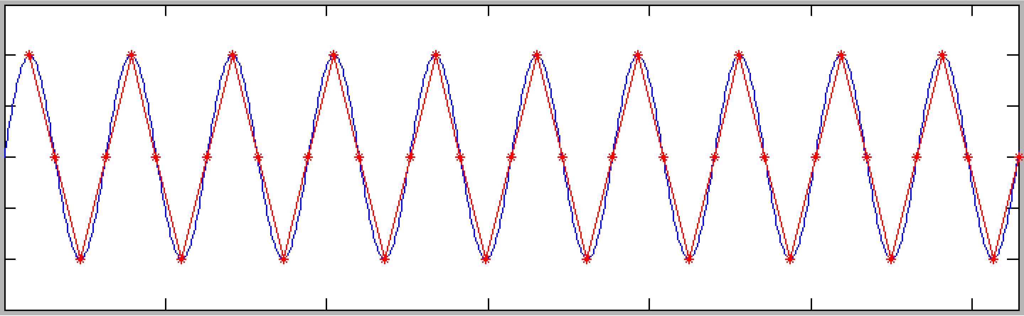
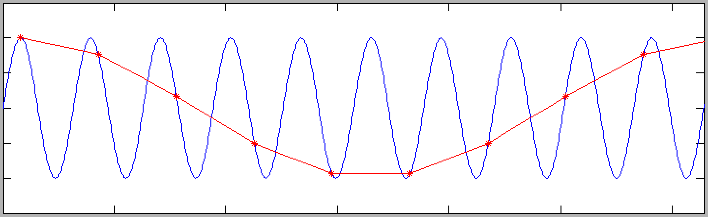
Aliasing
4 samples per cycle
0.9 samples per cycle
Notes:
Adapted from Figure 5.7 from from Luck, S.J. (2014). An Introduction to the Event-Related Potential Technique, Second Edition. Cambridge, MA: MIT Press. © MIT Press.
This material may be used for nonprofit research and education purposes only, and it may not be reprinted or distributed in any form including print and electronic forms.

